Slide 1
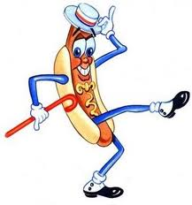

Hotdog and Sodas
You are running a hotdog stand where you sell hotdogs and soda. Each hot dogs cost $1.50 and each soda costs $0.50 an you made a total of $78.50. You sold a total of 87 hotdogs and sodas combined. You must report the total number of hotdogs and sodas sold. How many of each were sold?
Notes:
hook

Slide 2
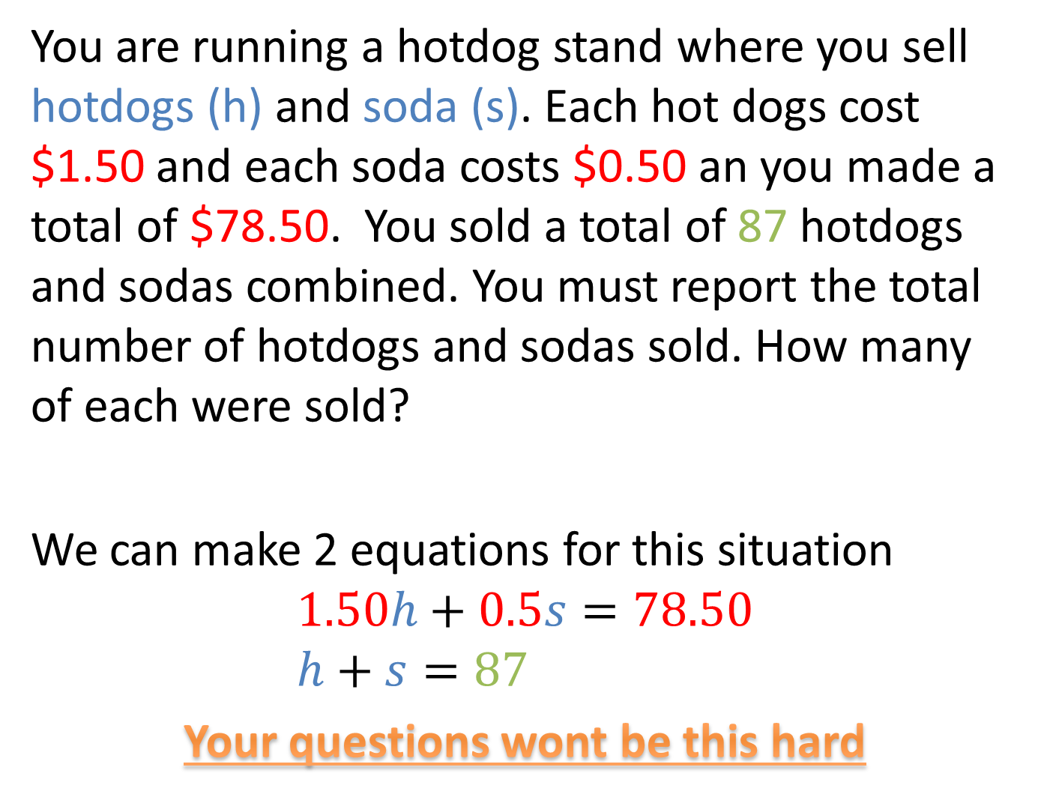
You are running a hotdog stand where you sell hotdogs (h) and soda (s). Each hot dogs cost $1.50 and each soda costs $0.50 an you made a total of $78.50. You sold a total of 87 hotdogs and sodas combined. You must report the total number of hotdogs and sodas sold. How many of each were sold?
We can make 2 equations for this situation
$$1.50h+0.5s=78.50 \\ h+s=87$$
Your questions wont be this hard

Slide 3
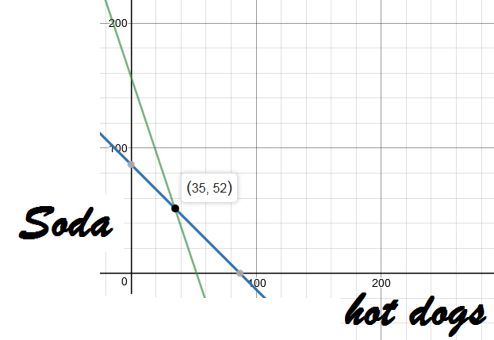

$$1.50h+0.5s=78.50 \\ h+s=87$$
If we graph these lines it looks like this
So they sold
35 hotdogs and 52 sodas

Slide 4
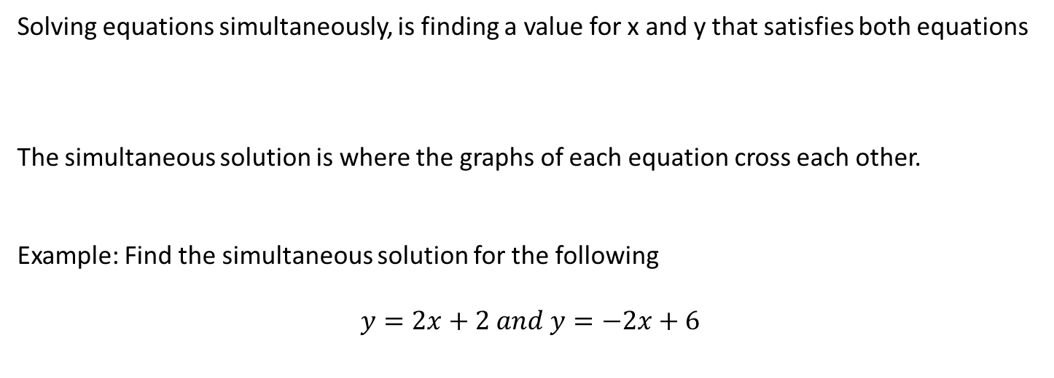
24
7
30
Date
Simultaneous Equations
EQ – How can we solve equations simultaneously using a graphs?
Solving equations simultaneously, is finding a value for x and y that satisfies both equations
The simultaneous solution is where the graphs of each equation cross each other.
Example: Find the simultaneous solution for the following
$$y=2x+2 and y=−2x+6$$
5
Notes:
Lesson objective (EQ)

Slide 5

24
7
30
Date
Simultaneous equations
EQ – How can we solve equations simultaneously using a graphs?
$$y=2x+2 and y=−2x+6$$
Step 1: Graph each of the lines
Step 2: Find the point where the lines intersect. (this is our solution)
5
Notes:
Guided practice Get the students to graph the lines

Slide 6
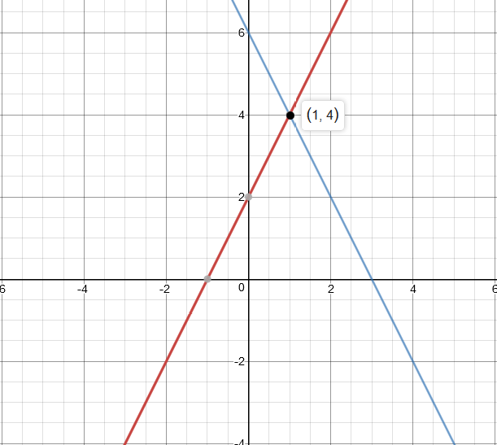

$$y=2x+2 and y=−2x+6$$
The simultaneous solution is when x=1 and y=4

Slide 7
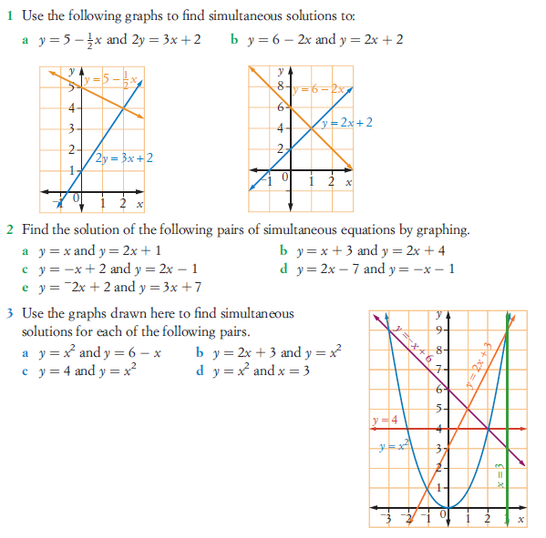
Have a go at these (pg 540 Nelson)
Notes:
Independent practice

Slide 8
Write your summary
What are the steps to solving a set of equations graphically?
Be prepared for the Index laws mini mini test
Notes:
Closure

